Slide 1
TAP LIGHT UP WORKSHOP
Project Created By: Jared Alt, Sterling Abrams, and Anh Thu Nguyen

Slide 2
About TAP
TAP otherwise known as the Technology Ambassador Program is an award winning program at GGC which aims to
Increase interest in programming the the number of students who commit to an IT major.
Provide outreach opportunities for GGC students through developing games and programs and presenting them to introductory STEM courses
Develop soft skills

Slide 3
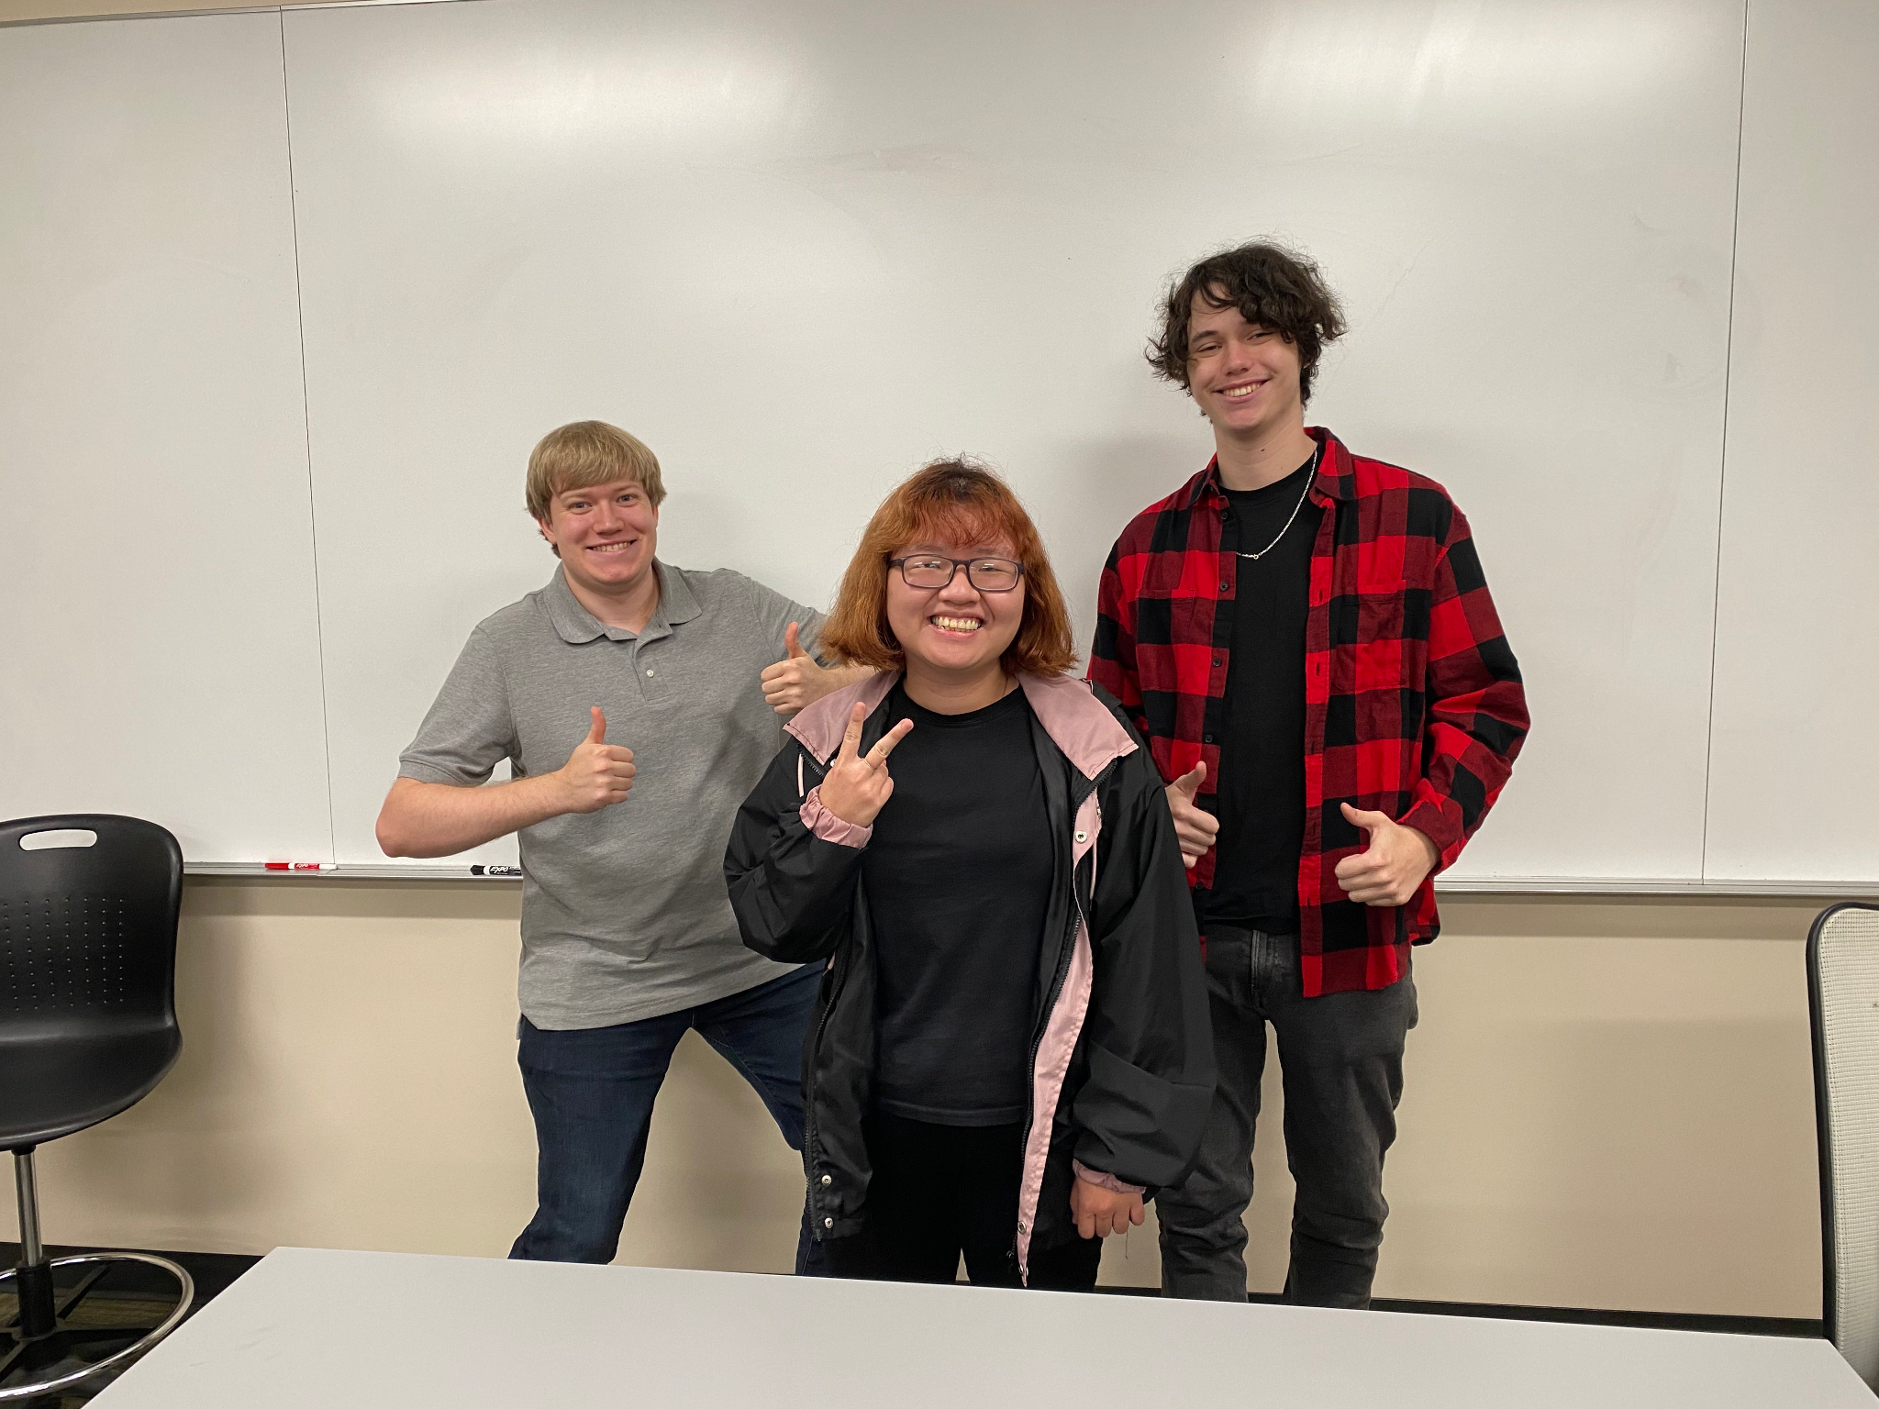
The Creators!
From left to right
Sterling Abrams, Anh Thu Nguyen, Jared Alt

Slide 4
Meet The Creators (Cont)
Jared:
Software Development student
No formal coding experience until this project
Sterling:
Digital media student
Advanced Scratch programing experience
Anh Thu:
Software Development international student
Intermediate in Java, C++, Scratch, Tynker

Slide 5
Let’s Get Started
The starter file should be provided to let everyone dive right in to the fun
Then go to https://scratch.mit.edu/
In the upper left side of the page click on “Create”
Click on “File” and “Load from Computer”
Select the .sb3 file that has been provided
You should be ready to start!
OR
https://scratch.mit.edu/projects/971345619/ Blank scratch file with all sprites

Slide 6
Let’s make a flashing light
o On the left, Scratch has organized the code blocks into different categories
o To grab a beginning block, go to Events and find the “When ____ key pressed”, click and drag it to the workspace
o There is a drop-down menu for you to select what key triggers the code, select the “left arrow”
o Go to the Looks category and grab the “Switch costume to ______” block
o Grab two of these
o They should snap together with the starting block when they get close together

Slide 7
Let’s make a flashing light (cont.)
Go to the Control category and grab the “Wait ____ seconds” block and sandwich it between your two “Switch costume to ______” blocks
You can use this block to adjust how long you want the light to stay on
The game uses .1 seconds
On the dropdown menu for the top costume switch block, select the “yellow light on” costume and on the bottom, select the “yellow light off” costume
Now click the green flag and test it out
If it works, repeat for the blue, green, and red lights

Slide 8
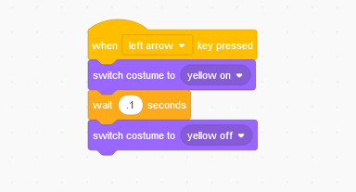
Checkpoint

Slide 9
Let’s make the falling arrows
Like before, make a new sprite by going to the cat head icon and upload or create your own “yellow arrow”
If it is not facing the right way, don’t worry there is a simple way to fix it
Drag the sprite until it is higher than the matching color light
Near the top of the screen

Slide 10
Let’s make the falling arrows (Cont.)
o We will need the following blocks for the first half of the arrows
o Events “when (green flag) clicked”
o Control “repeat ___ “
o Control “Wait ___ seconds”
o Control "create clone of ____”
o Use the green flag clicked as the start, then attach the repeat block, inside the repeat block, add the wait and create clone blocks

Slide 11
Let’s make the falling arrows (Cont.)
o Now for the other half of the falling arrows
o Control “When I start as a clone”
o Motion "point in direction __”
o Motion “glide __ secs to X: __ Y: __”
o Control “delete this clone”
o Attach them together, the __ secs will control the speed, for the glide, the X should be the same as the arrow and light, the Y should be around -200
o Repeat for the other arrows

Slide 12
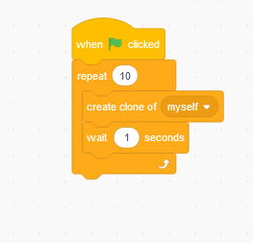
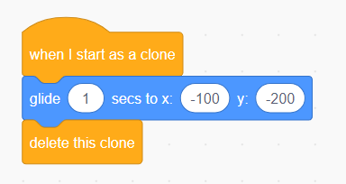
Checkpoint

Slide 13
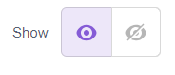
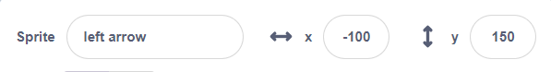
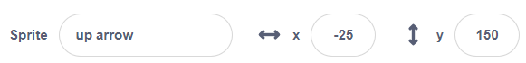
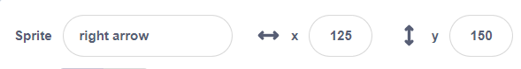
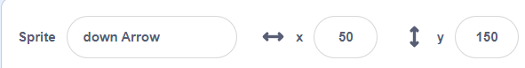
Common Error: “My arrow is gone”
First step, check to see if the arrow is visible
This is found under the play space on the right-hand side
Second step, Scratch runs code blocks if you click on them, your arrow might have moved off screen, use these coordinates for the arrows to put them back

Slide 14
Time to add some hit registry
o On your arrows, grab the blocks:
o Events “when ___ is pressed”
o Control “if <___> then”
o Control “delete this clone”
o Sensing “touching ______ ?”
o Attach the delete clone inside the if sandwich
o Place the touching block in the if statement socket
o The touching block should be set to the matching color light

Slide 15
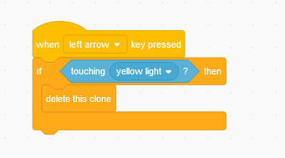
Checkpoint

Slide 16
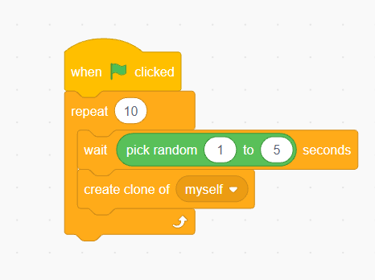
Now to add Some Flair
o Under the Operators category, there is “pick random __ to __” you can slot this into the wait __ seconds in your arrow spawning loop. This will make the arrows spawn at random times so all the arrows don’t fall together every time
o Under Variables, click “Make a Variable” and name it score

Slide 17
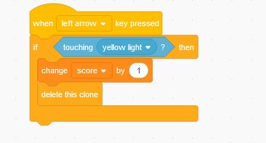
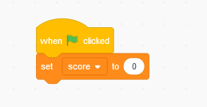
Now to add Some Flair (Cont)
On the right side of the screen, near the sprites there is a section labeled “stage”
Select it, then drag out the
Events “when (green flag) clicked”
Variables: set score to 0
Select your arrows again, and drag out Variables: change score by 1
Slot it into the hit registry, inside the if statement, before the delete clone

